Slide 1

Class 23:
Blooming Sidechains!
Cryptocurrency Café
UVa cs4501 Spring 2015
David Evans

Slide 2
Plan
Bloom Filters
Design and Analysis
Use in Bitcoin
Merged Mining
Sidechains
Thursday, 6pm Commerce School 223
“Entrepreneurial and Career Ventures in the world of Digital Currency” Panel
Friday, 10:45am Rice 242
Suman Jana, “Rise of the Planet of the Apps: Security and Privacy in the Age of Bad Code”
Project Presentations will be April 20, 22 and 27.

Slide 3
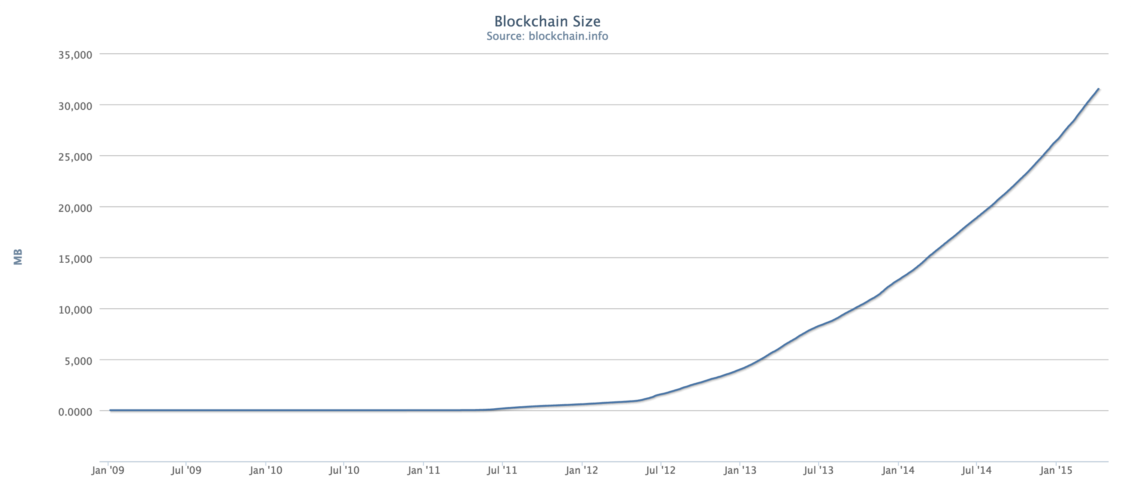
32 GB

Slide 4
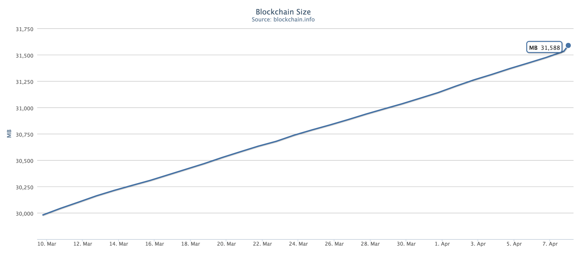
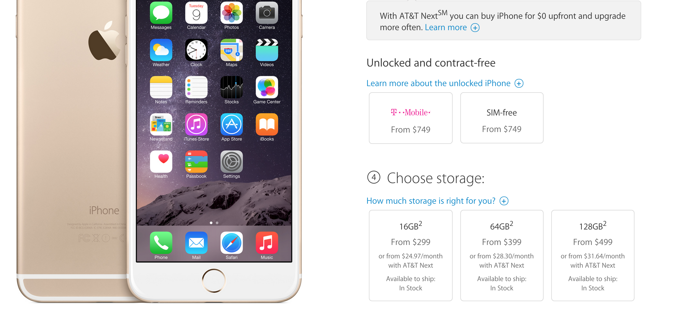

Slide 5
SPV Nodes
Simplified Payment Verification
SPV Wallet
filter
Full Node
blocks matching filter

Slide 6
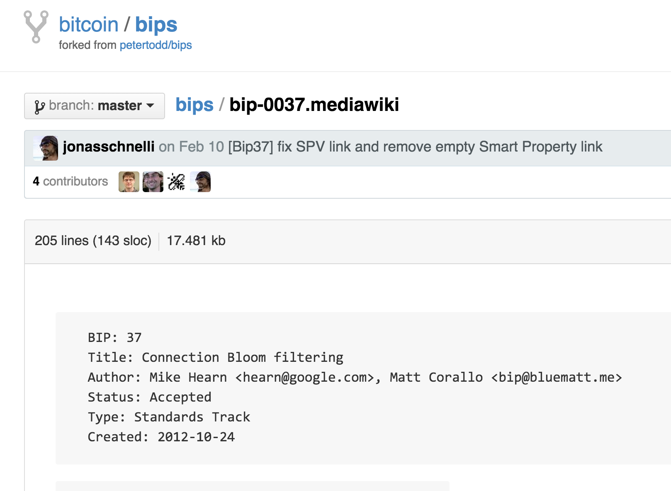

Slide 7
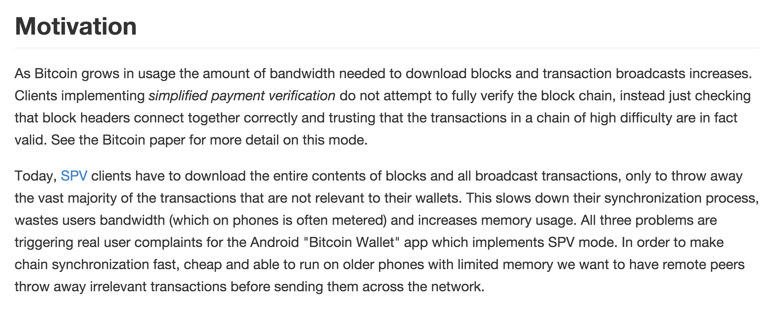

Slide 8
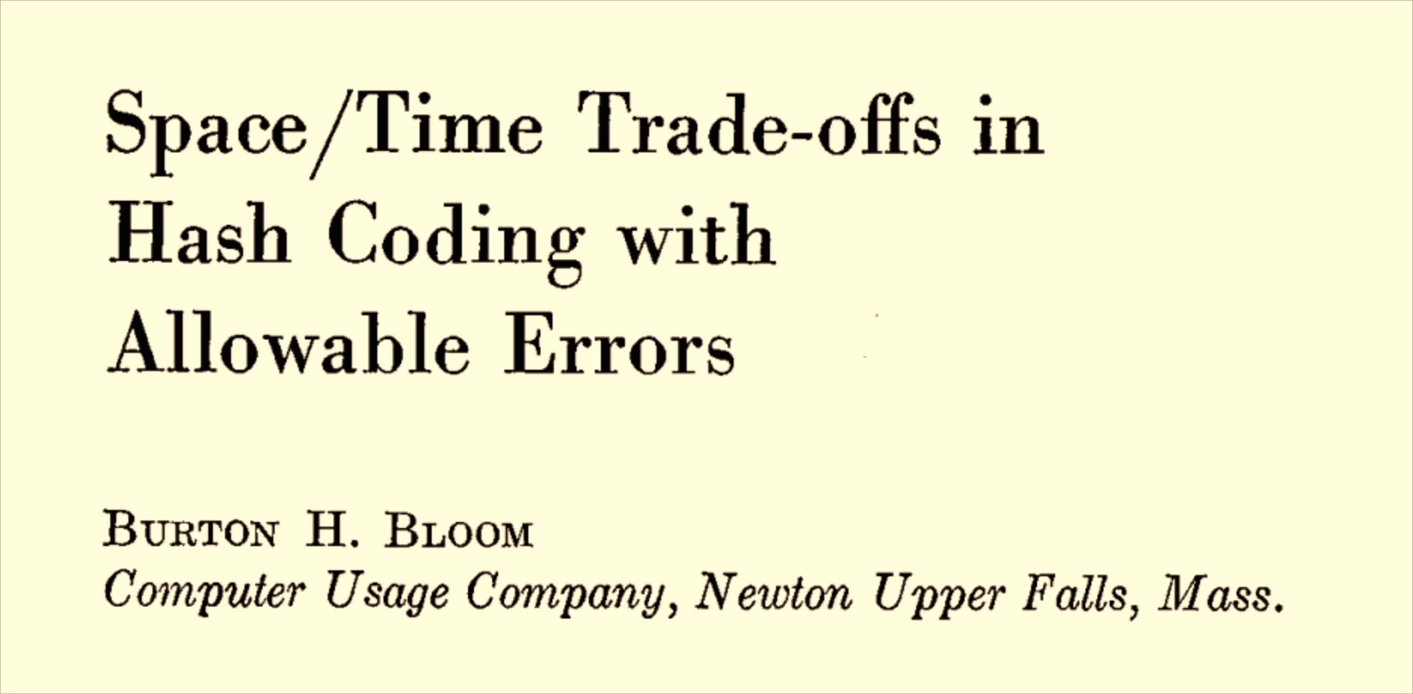
Bloom Filters

Slide 9
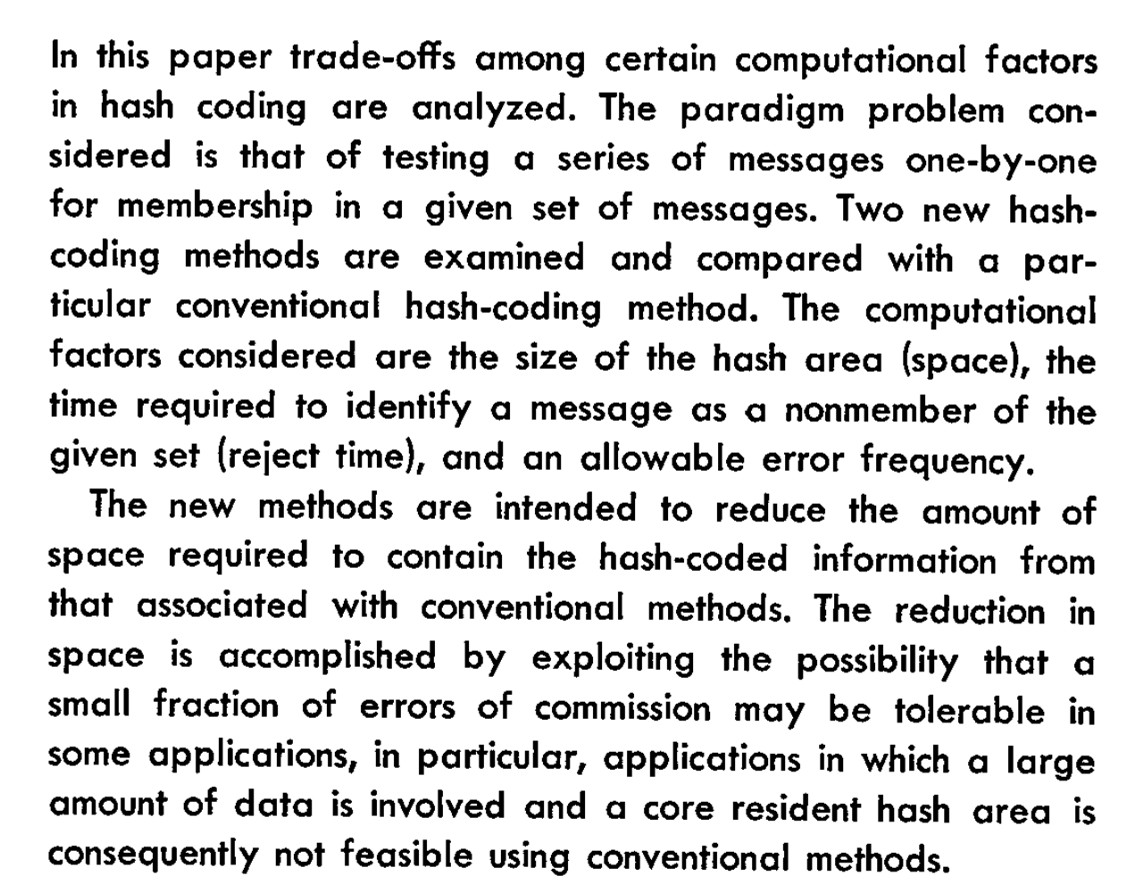

Slide 10
Conventional Hash Table
Store collection of N b-bit elements, using k > N cells.
H is pseudorandom function
H(x) ➔ [0, k)

Slide 11
Conventional Hash Table
Store collection of N b-bit elements, using k > N cells.
H is pseudorandom function
H(x) ➔ [0, k)

Slide 13
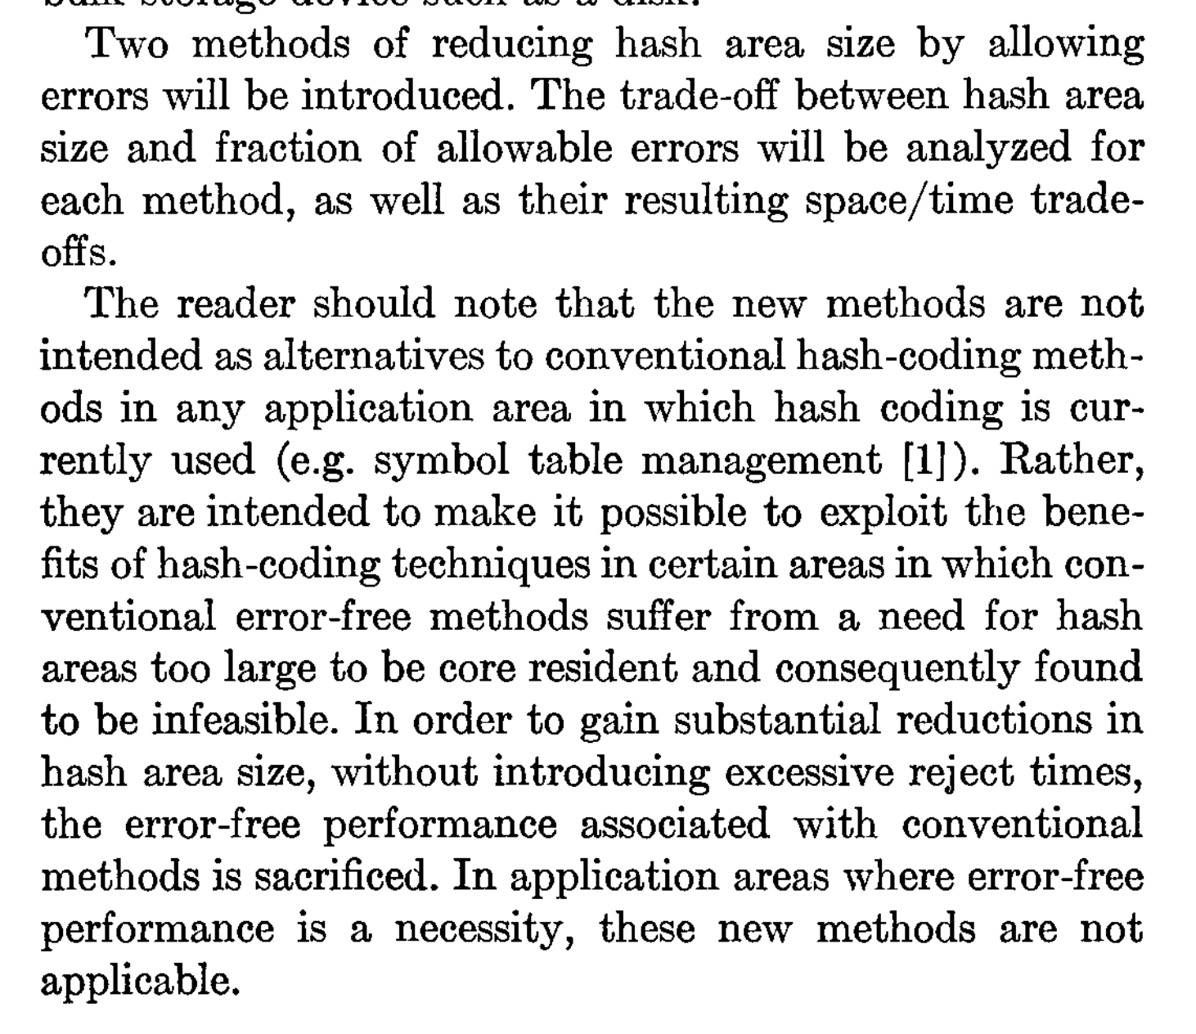

Slide 14
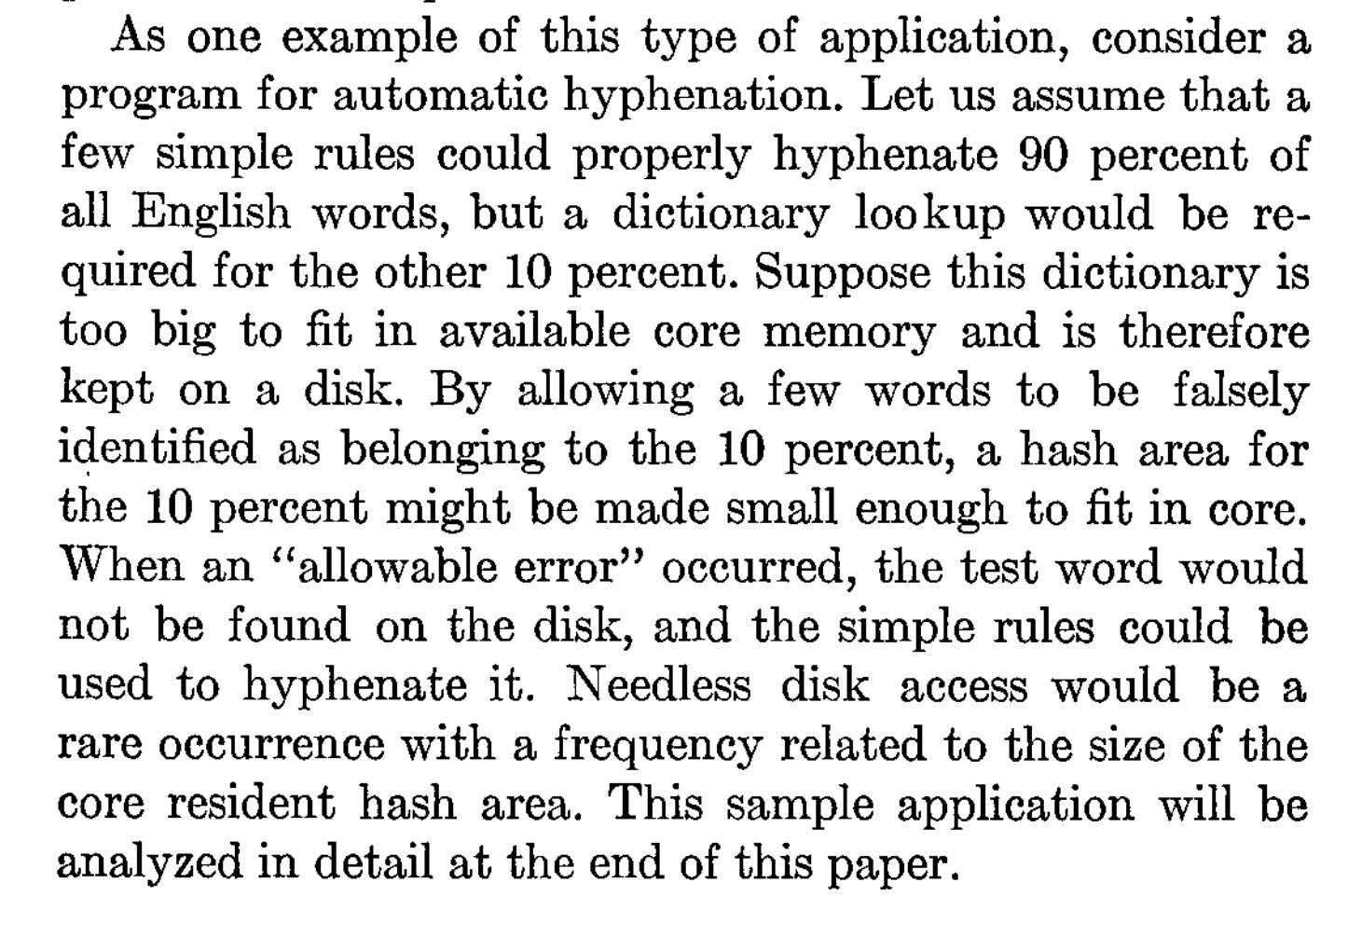
How does Bloom’s application compare to use by bitcoin SPV nodes?

Slide 15
Bloom Filter Design

Slide 18
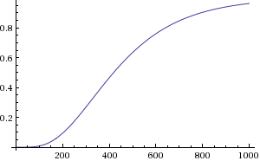
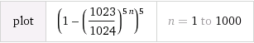
m: bits in array
k: number of hashes
n: number of elements
Probability of false match:
(1 – (1 – 1/m)^{kn})^{k}

Slide 19
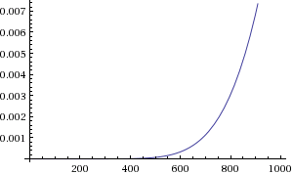
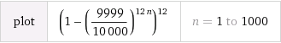
m: bits in array
k: number of hashes
n: number of elements
Probability of false match:
(1 – (1 – 1/m)^{kn})^{k}

Slide 20
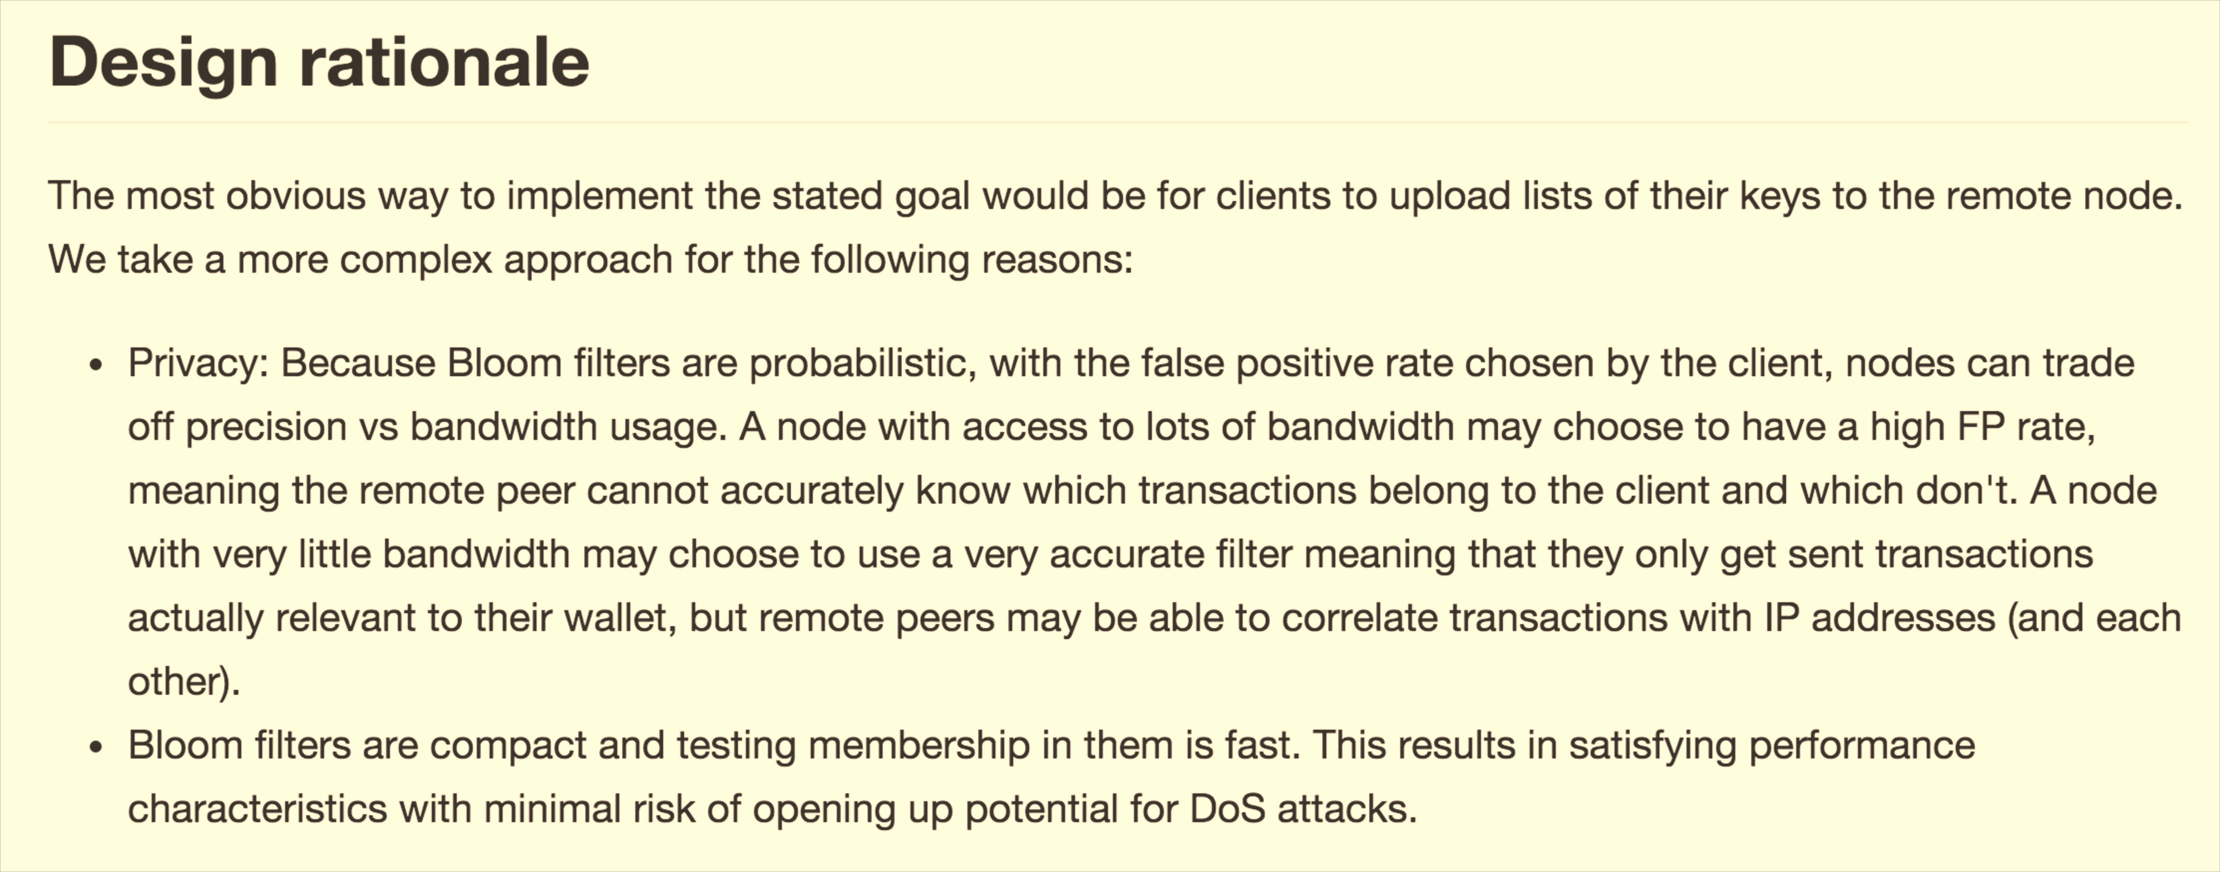
Do Bloom filters really provide privacy?

Slide 23
Merged Mining

Slide 24
Pointcoin 0
Pointcoin 1
…
Pointcoin 6764
Difficulty: 8,324,713
Hash rate: ~0 TH/s
Bitcoin 0
Bitcoin 1
…
Bitcoin 351247
Difficulty: 49,446,390,688
Hash rate: 310K TH/s
Should PointCoin Pizza be worried?

Slide 25
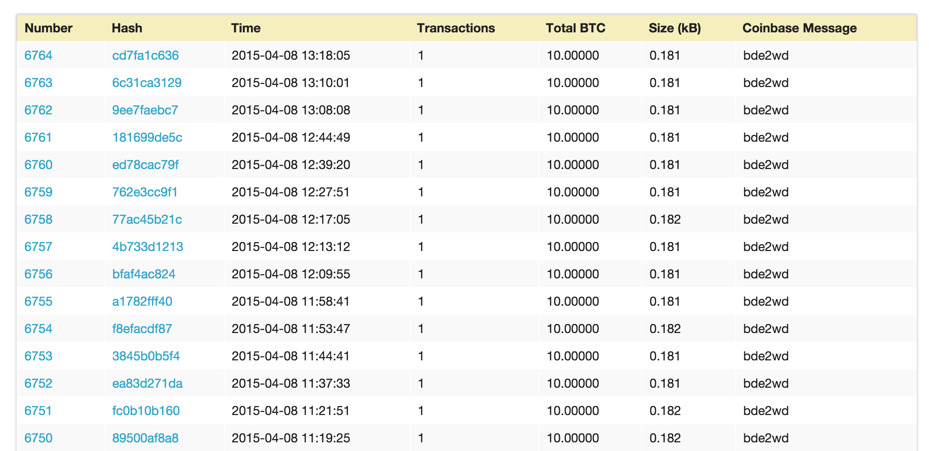
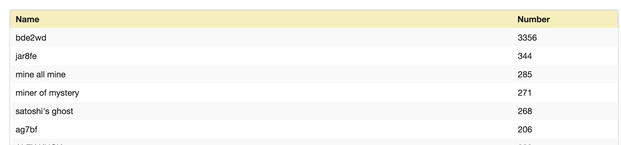
http://blockexplorer.bitcoin-class.org/

Slide 26
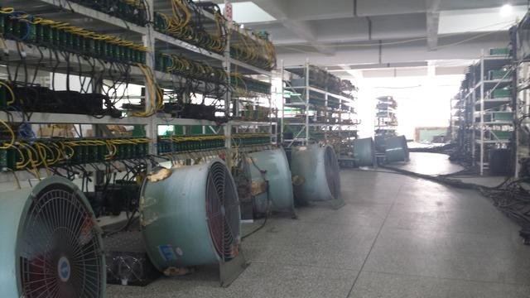
SHA-256 Proof-of-Work Cryptocurrency

Slide 27
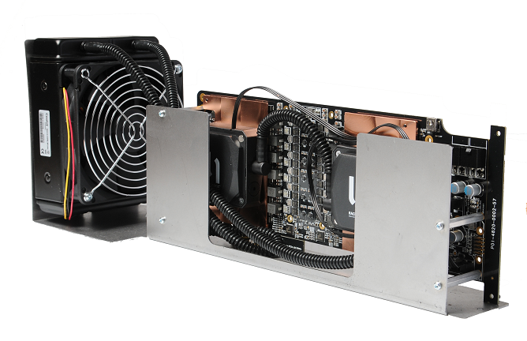
Merged Mining
Goal: Enable using same hashing power to mine both Bitcoin and Namecoin (with different difficulty)

Slide 29
https://explorer.namecoin.info/blocks/block_225529.txt

Slide 30
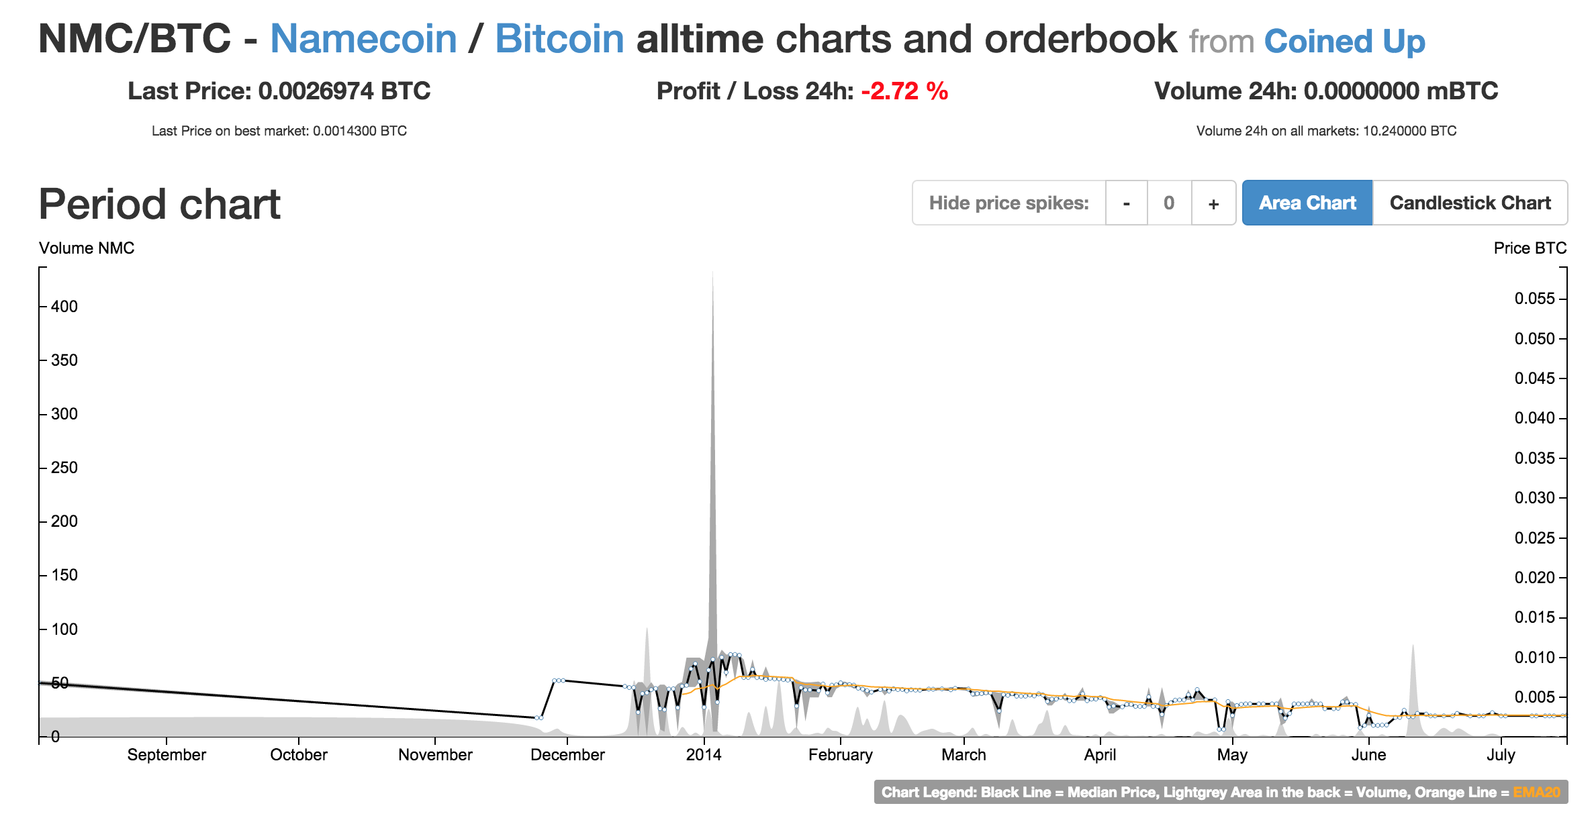

Slide 31
Pointcoin 0
Pointcoin 1
…
Pointcoin 6764
Difficulty: 8,324,713
Hash rate: ~0 TH/s
Namecoin 0
Namecoin 1
…
Namecoin 225529
Difficulty: 16,527,985,062
Hash rate: 110K TH/s
Bitcoin 0
Bitcoin 1
…
Bitcoin 351247
Difficulty: 49,446,390,688
Hash rate: 310K TH/s

Slide 32
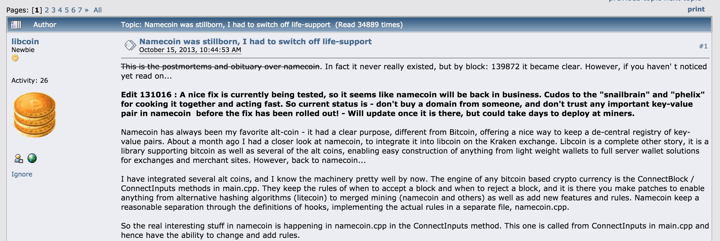
Namecoin Bug

Slide 34
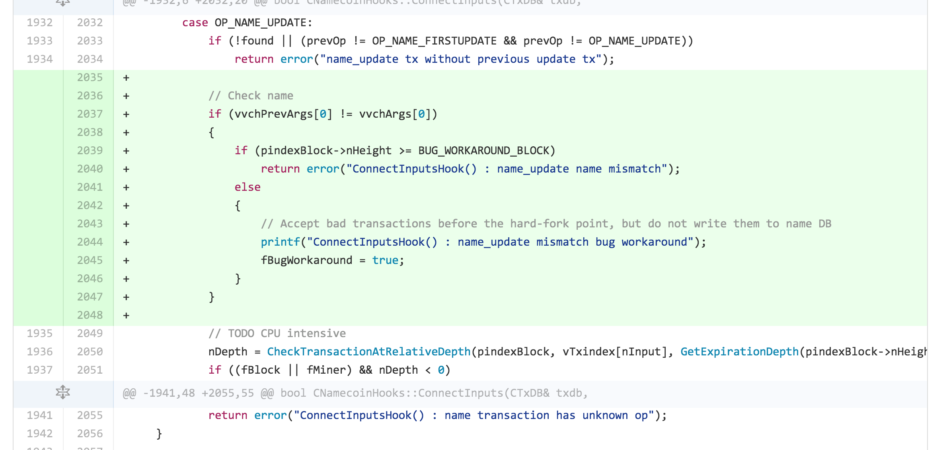
https://github.com/namecoin/namecoin/commit/d70d01ff77310d3755891cb43cb2700b553019f4

Slide 35
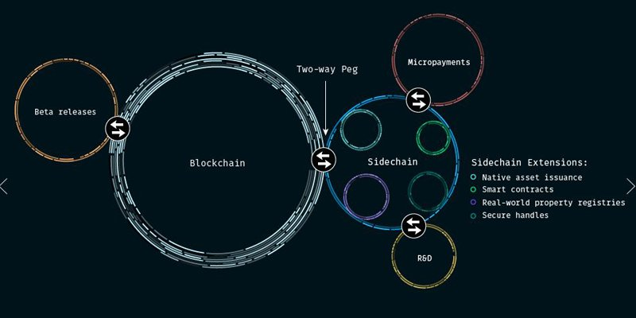
Sidechains

Slide 36
Why is it hard to evolve bitcoin?

Slide 37
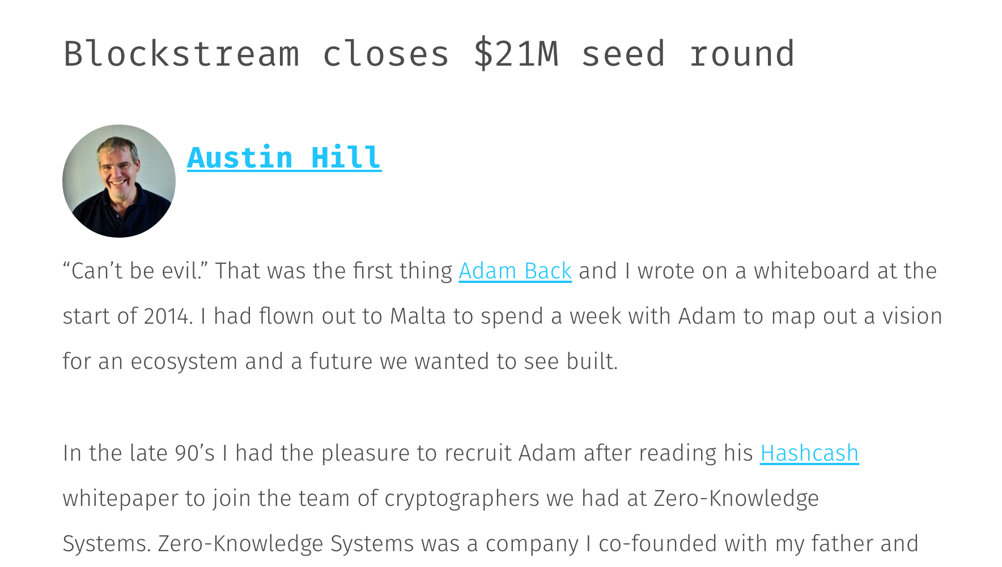
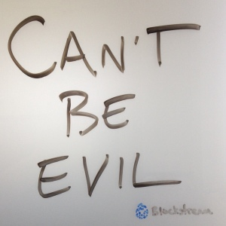

Slide 38
One-Way Peg
Main Chain
Bitcoin 351247
Bitcoin 351248
…
Bitcoin 372385
Transaction: “Proof of burn” for coin x
Proof: mint sidecoins
Sidecoin 0
Sidecoin 1
…
Sidecoin 1423

Slide 39
“Proof of Burn/Freeze”

Slide 40
Two-Way Peg
Main Chain
Bitcoin 351247
Bitcoin 351248
…
Bitcoin 372385
Transaction: “Proof of freeze” for coin x
Transaction: “Proof of burn” in sidechain for coin x
Proof: mint sidecoins
Sidecoin 0
Sidecoin 1
…
Sidecoin 1423
Note: not possible without changing bitcoin

Slide 41
Resumption Proof

Slide 42
Charge
Projects should be making good progress now!
Thursday, 6pm Commerce School 223
“Entrepreneurial and Career Ventures in the world of Digital Currency” Panel
Friday, 10:45am Rice 242
Suman Jana, “Rise of the Planet of the Apps: Security and Privacy in the Age of Bad Code”
Project Presentations will be April 20, 22 and 27.

